Slide 1


KUBERNETES FAILURE PREDICTION USING MACHINE LEARNING
Explore how machine learning algorithms can predict failures in Kubernetes environments, enhancing reliability and performance in cloud applications.

Slide 2

TOPICS COVERED
PROJECT OVERVIEW
PROBLEM STATEMENT
DATASET INFORMATION
PROJECT STRUCTURE
TECHNOLOGIES USED
MODEL DEVELOPMENT PROCESS
MODEL PERFORMANCE
FUTURE IMPROVEMENTS
AGENDA

Slide 3

KUBERNETES CLUSTER FAILURE PREDICTION
Goal of the Project
Target Issues
Machine Learning Approach
Proactive Detection
Focus on critical issues such as pod crashes, resource bottlenecks, and network failures that affect cluster performance.
The primary goal is to predict Kubernetes cluster failures before they occur, enhancing system reliability.
The objective centers around proactive failure detection, enabling timely mitigation actions to prevent downtime.
Utilize machine learning models that analyze network traffic and system resource metrics for accurate predictions.

Slide 4
CHALLENGES IN KUBERNETES CLUSTERS
Pod Crashes
Frequent pod crashes disrupt service availability and impact user experience.
Network Failures
Network failures can lead to communication breakdowns between services, affecting system performance.
Resource Bottlenecks
Insufficient CPU, memory, or disk resources can lead to performance issues and slow response times.
Service Disruptions
Service disruptions can occur due to various issues, leading to downtime and loss of user trust.

Slide 5
Dataset Overview
Flow Information
Includes essential metrics such as Flow ID, Flow Duration, Flow Bytes/s, and Flow Packets/s.
Network Metrics
Captures critical data like Source/Destination IP & Port, Protocol, and Timestamp for precise tracking.
Traffic Features
Analyzes Packet Lengths, Forward/Backward Packets, and IAT (Inter-Arrival Time) for deeper insights.
Flags & Indicators
Focuses on TCP Flags, PSH Flags, and ACK Flags to understand connection states and behaviors.
Resource Utilization
Monitors CPU, Memory, Disk 10, and Network 10 to assess system performance during data flows.
Preprocessing Techniques
Handles missing values and normalizes numerical features to ensure quality data for analysis.

Slide 6
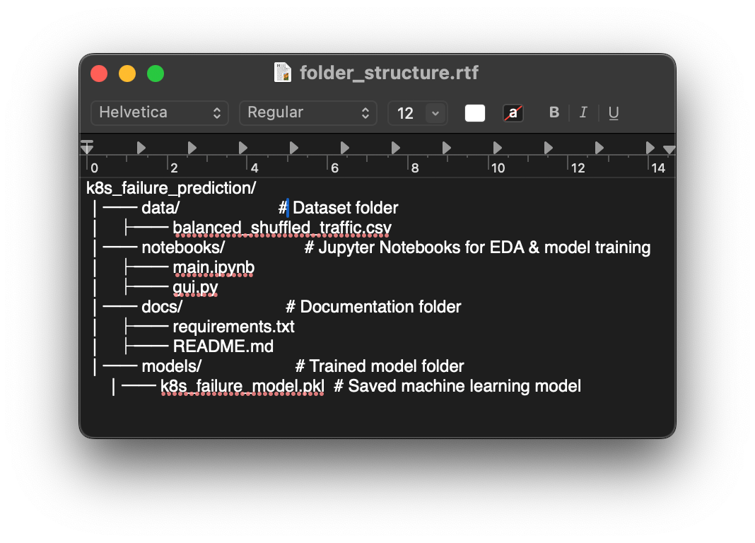

Slide 7
Technologies Used
Programming Language: Python 3.9
Python 3.9 is the core programming language chosen for its versatility and ease of use.
Machine Learning Libraries: Scikit-learn, Pandas, NumPy
Scikit-learn, Pandas, and NumPy are utilized for efficient data analysis and machine learning tasks.
Framework: Flask (for API deployment)
Flask is employed for API deployment, providing a lightweight and flexible framework.
Orchestration: Kubernetes (K8s)
Kubernetes (K8s) is implemented for orchestration, managing and scaling containerized applications.

Slide 8
Model Development
Data Preprocessing
Addressing missing values, feature scaling, and normalization ensures data quality.
Model Selection
Choosing the Random Forest Classifier for its robustness and accuracy in predictions.
Training the Model
Utilizing the preprocessed data to train the Random Forest model effectively.
Model Evaluation
Assessing the model's performance through accuracy metrics and classification reports.

Slide 9

87%
Accuracy
Precision, Recall,
F1-Score.
Evaluation Metrics

Slide 10

FUTURE IMPROVEMENTS
Real-Time Monitoring: Integrate with Prometheus & Grafana for live monitoring of Kubernetes clusters.
Advanced Models: Implement LSTMs and Transformers for better prediction accuracy.
Automated Failure Mitigation: Take proactive actions based on failure predictions.
Docker & Cloud Deployment:
Use Docker to containerize the solution.
Deploy on AWS EKS or Minikube for scalability.

